Slide 1
ARM Templates Tips, Tricks & Advanced Techniques
Sam Cogan
Solution Architect, Willis Towers Watson & Microsoft MVP
samcogan.com
@samcogan

Slide 2

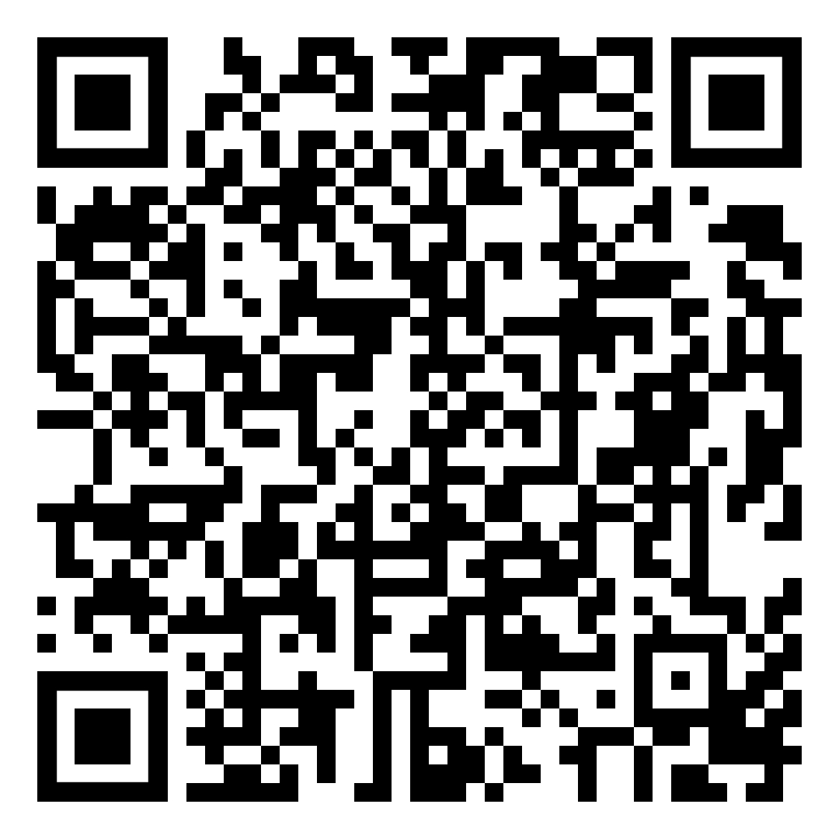



About Me
Sam Cogan
Solution Architect – Willis Towers Watson
Microsoft Azure MVP
samcogan.com
@samcogan
sam-cogan

Slide 3
1. Functions
Numeric – add, div, min, max, copyIndex
String – concat, contains, split, replace, trim
Resource – List Keys, ResourceGroup
Deployment – Parameters, Variables
Comparison – equals, greater, less
Logical – and, or, not, if
Array – concat, length, range, take, union
https://docs.microsoft.com/en-us/azure/azure-resource-manager/resource-group-template-functions
Notes:
FunctionExamples.json – UniqueString, ResourceGroup, ListKeys, toLower
SaSToken.json – generating a SAS token with ListKeys
Mod.json – using mod to alternate between storage accounts

Slide 4
2. User Defined Functions
"value":"[take(concat(toLower(replace(parameters('prefix'),' ','-')), uniqueString(resourceGroup().id,parameters('prefix'))),15)]"
Notes:
Example – using user defined functions to simplify name generation
Use is mainly limited to simplifying large, regularly used names etc.
Limitations
The function can't access variables.
The function can only use parameters that are defined in the function. When you use the parameters function within a user-defined function, you are restricted to the parameters for that function.
The function can't call other user-defined functions.
The function can't use the reference function.
Parameters for the function can't have default values.

Slide 5
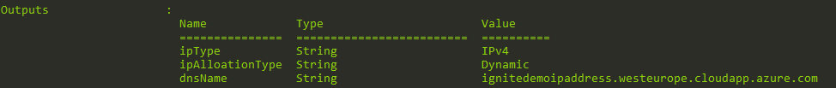
3. Outputs
Notes:
Each ARM Template has an Output section
This can contain any information that is available to the template
Resource ID’s
Keys
Parameters and/or variables
Whole resources
Output data is passed to the caller:
PowerShell
Build Tool
Another ARM Template

Slide 6


4. Nested Templates
Notes:
Calling a template from inside another template
Great for re-use and modularisation
Can be used for primitive conditional logic
Can return output to the calling script
Required for some techniques, including cross subscription deployments

Slide 7
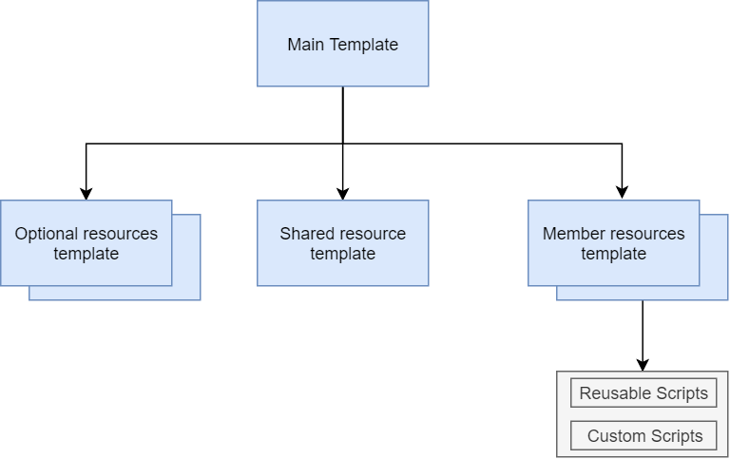
4. Nested Templates

Slide 8


5. T-Shirt Sizing

Slide 9
6. Conditions
"condition": "[equals(parameters('NetworkInterfaceType'),'Public')]"
"publicIPAddress": "[if(variables('requirePublicIP'), variables('publicIP1'), json('null'))]"

Slide 10


7. Deployment Modes
Incremental
Complete
Notes:
Show removal of resource in demo RG
Show no-op for conditions and how they are not affected

Slide 11



8. Subscription Level Deployments

Slide 12
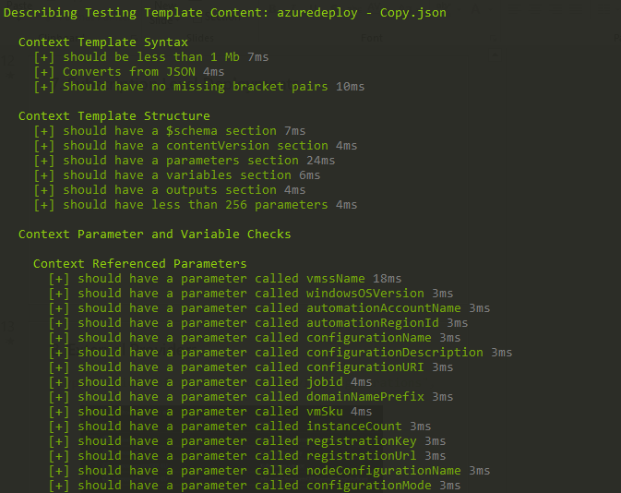
9. Testing

Slide 13


10. Container Jobs
https://aka.ms/armtemplatepreviews

Slide 14
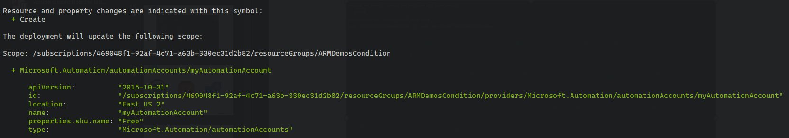
11. What-If?
https://aka.ms/armtemplatepreviews

Slide 15
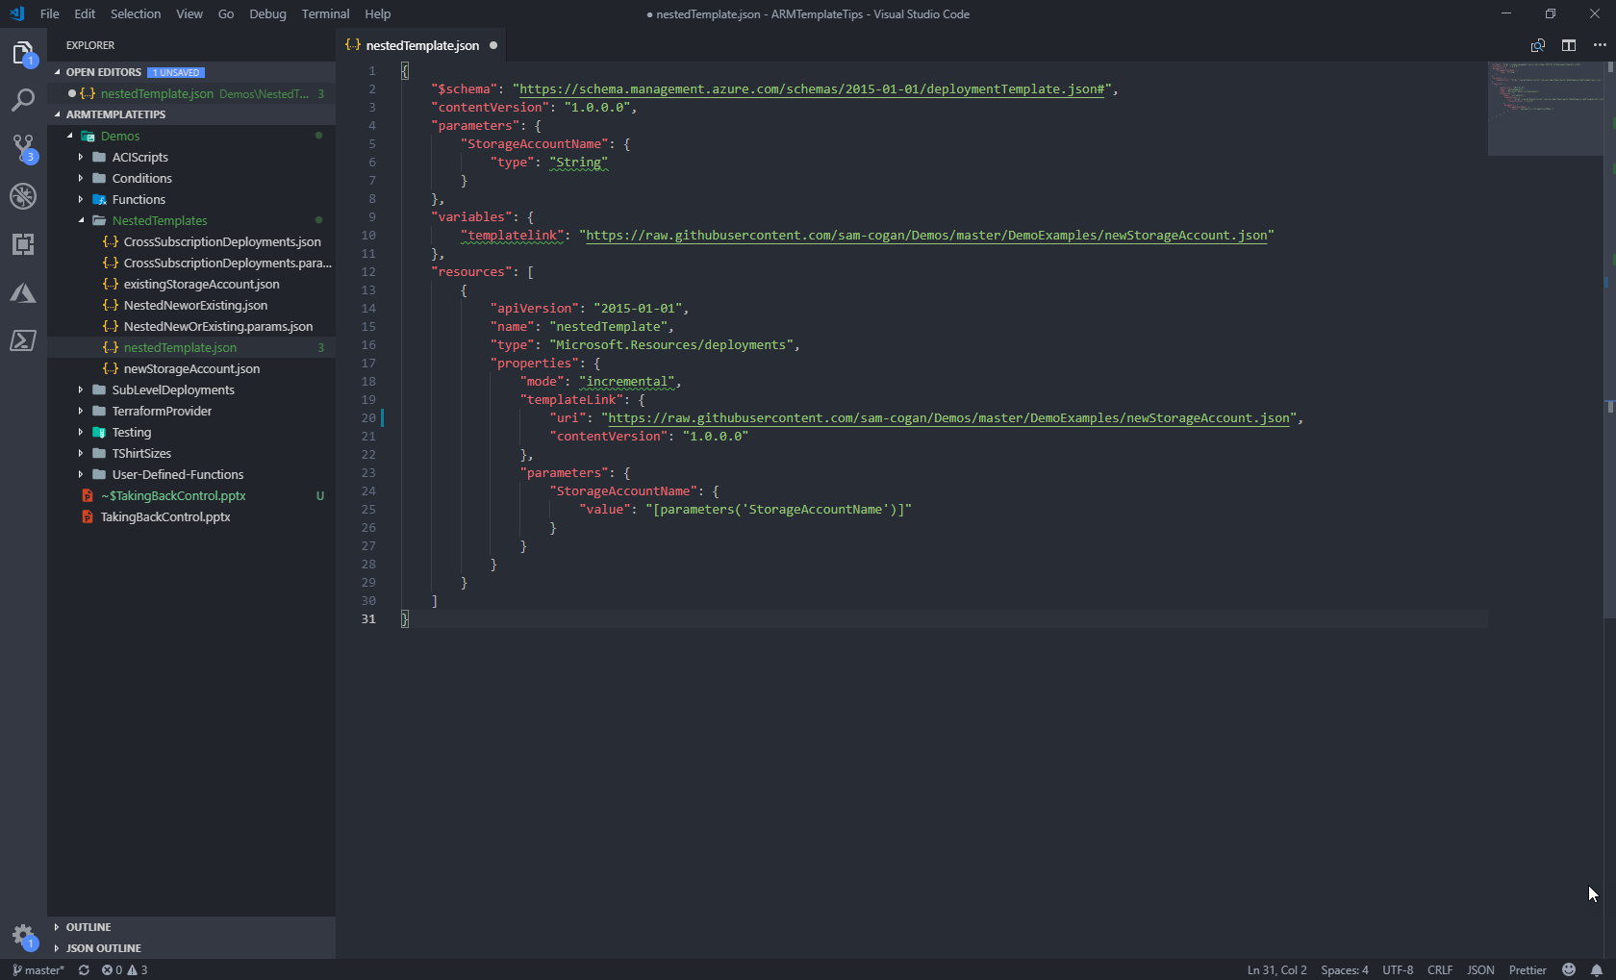
12. Visual Studio Code

Slide 16



13. Continuous Delivery

Slide 17
About Me
Sam Cogan
Solution Architect – Willis Towers Watson
Microsoft Azure MVP
samcogan.com
@samcogan
sam-cogan

Slide 18







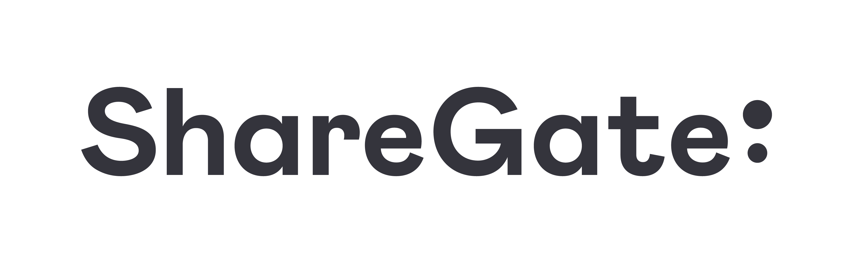






Thank you Sponsors!

Slide 19
Please submit your feedback
Don’t forget to rate this session in the conference app
Thank you!

